Slide 1
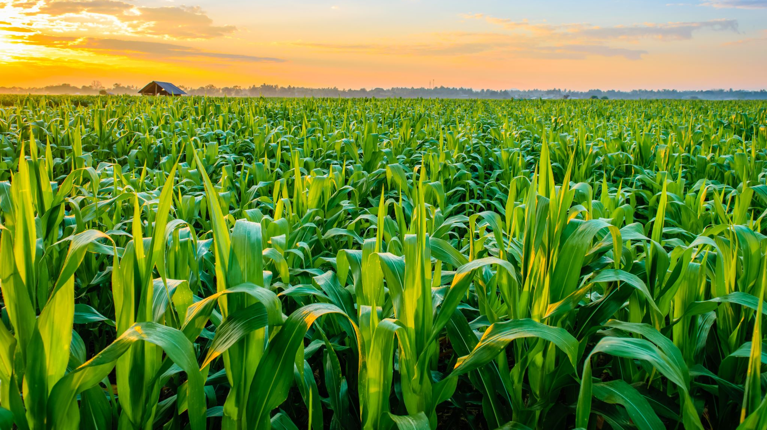
Bayesian Hierarchical Model for Maize Yield
Alice Huang

Slide 2
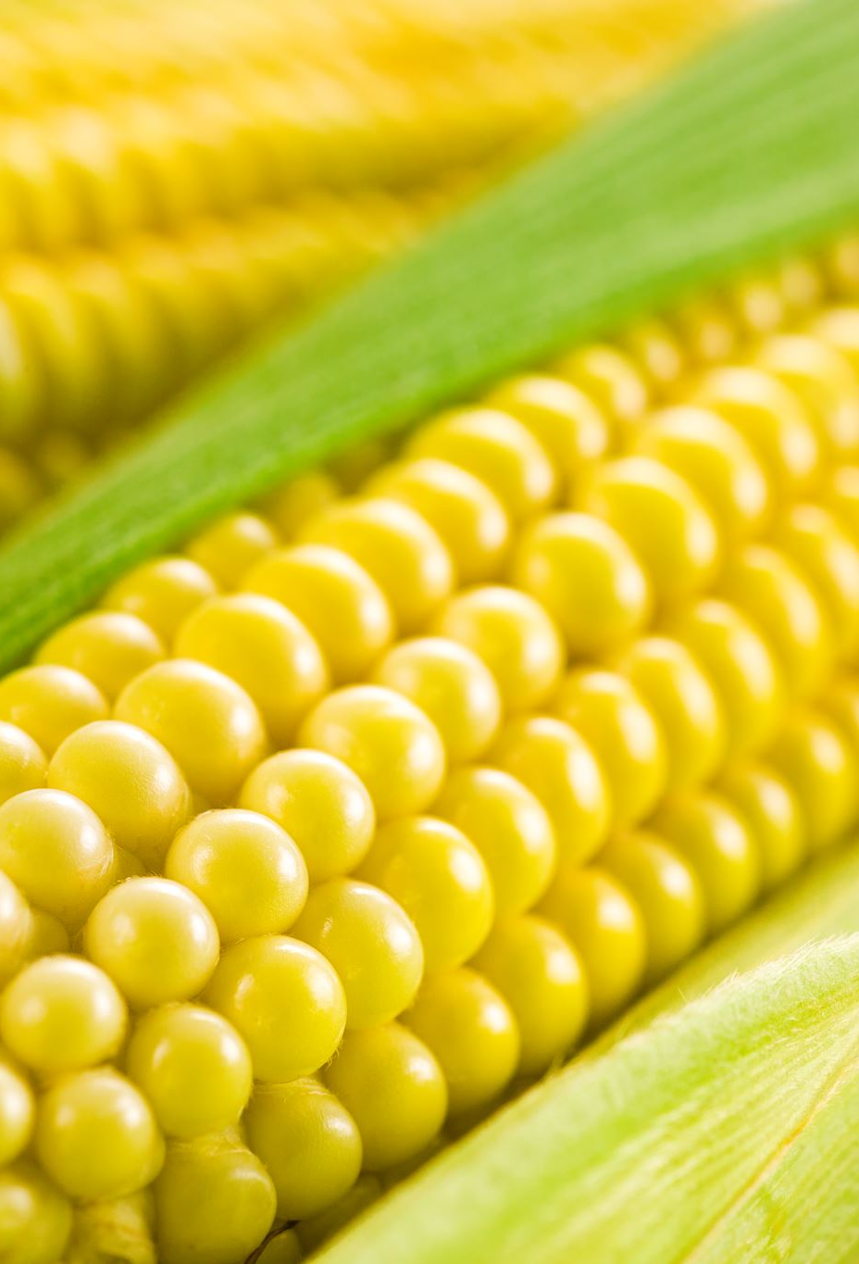
Introduction
Maize (a.k.a corn in North America) is one of the most commonly consumed crops in the world
Used to make animal feed, cornstarch, corn syrup, and more
We are interested in factors that influence its yield
Implications for food availability, business profitability

Slide 3
Data
Downloaded from https://data.mendeley.com/datasets/7m3pjrz52x
Collection of data from many different studies on maize yield
Featured in paper by Li et al (2019)
A global synthesis of the effect of water and nitrogen input on maize (Zea mays) yield, water productivity and nitrogen use efficiency
In this project I focus on maize yield data from China
Help control for correlation due to country’s agriculture laws & policies, farming techniques, technology
More data available for different soil types
Data was more complete
One of the biggest producers of maize

Slide 4


Potential Covariates Based on Previous Literature
Geography
(e.g. country)
Water level (irrigation + rainfall)
Soil Texture (affects water retention, drainage)
Mean Annual Temperature (MAT)
Nitrogen level (fertilization)
Density (PPH) (competition for nutrients)
Soil Organic Content (SOC)
Maize yield
(tonnes/hectare)

Slide 5

Research Question
How should we expect maize yield to change given changes in soil type, water level, nitrogen level, soil organic content, mean annual temperature and plant density?

Slide 6
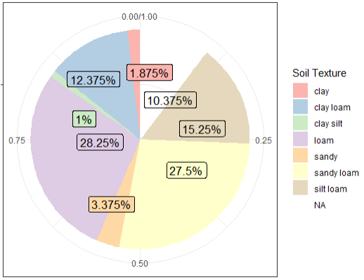
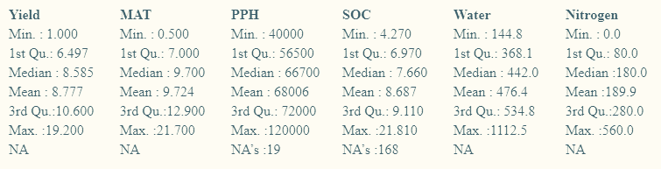
Summary Statistics
Aggregated 800 observations from 52 studies on maize yield in China, 39 locations

Slide 7

Missing Data
80 rows missing Soil Texture type
Will be a problem as I will try to build a Bayesian hierarchical model with soil being a level in the hierarchy
May not be able to use this data
Some soil types missing lots of data on Plants Per Hectare (PPH), don’t have a lot of observations to begin with
PPH seems to have been kept constant in other soil groups.
May not be able to use it in model
SOC missing 168 observations, wasn’t significant anyway

Slide 8
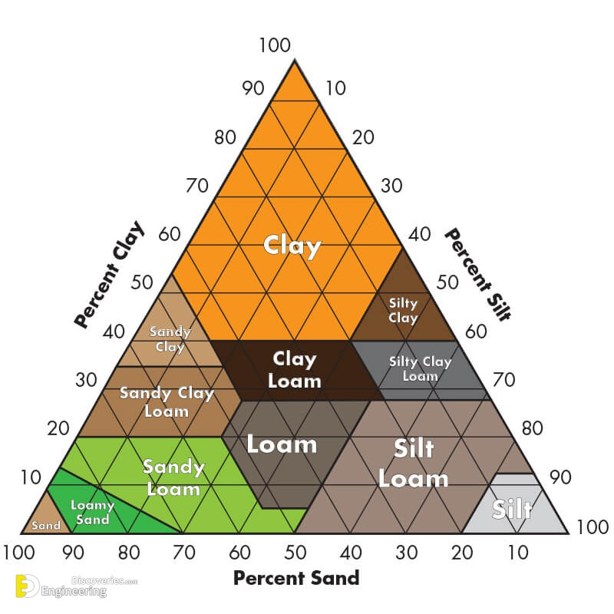
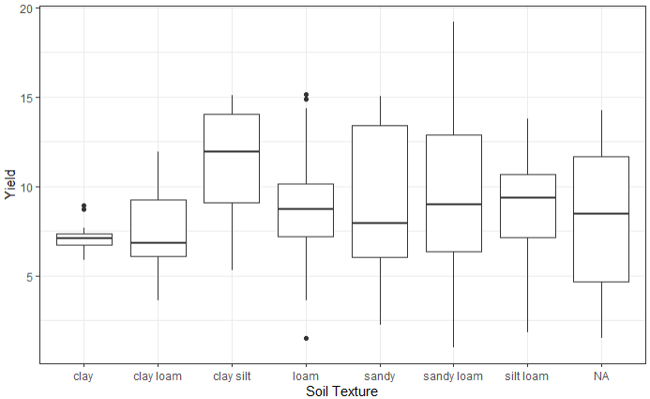
Soil Type and Maize Yield
Some types of soil hold onto water better than others
Important since maize has shallow roots
Particle size, Water retention: sand < silt < clay
Soil texture will be recoded into integer factor variable based on expected water retention computed from particle size and percentage of sand, silt, clay

Slide 9
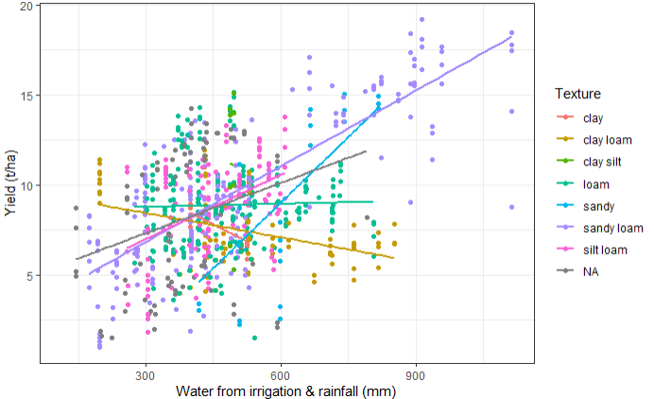
Water and Maize Yield
For finer soil types like clay loam, increasing water seemed to either have little effect or slightly negative effect on yield
For coarser soil types like sandy loam, (worse at retaining water) increasing water seemed to increase yield

Slide 10
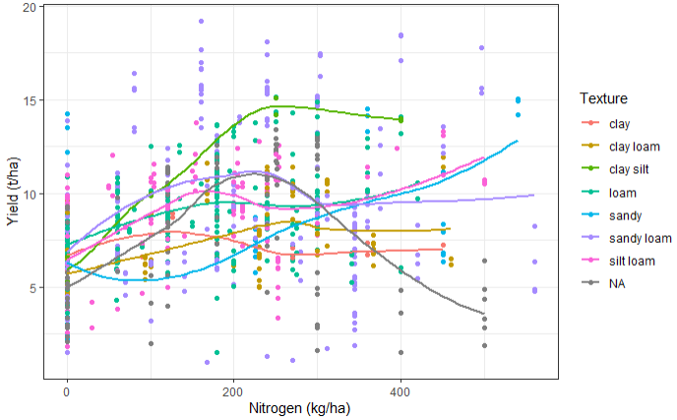
Nitrogen and Maize Yield
For most soil types, as nitrogen increases, yield either doesn’t change much, or increases slightly but plateaus after
Exception: sandy soil, coarsest type which does not hold onto water/nutrients well

Slide 11
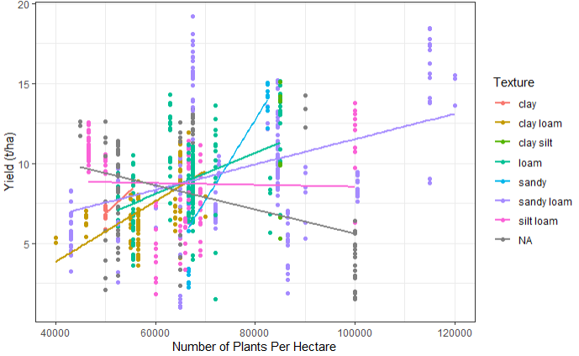
Plant Density and Yield
For most soil types except silt loam, increasing plant density seemed to increase yield
Perhaps farmers already knew how dense to plant their seeds before plants start competing with each other

Slide 12
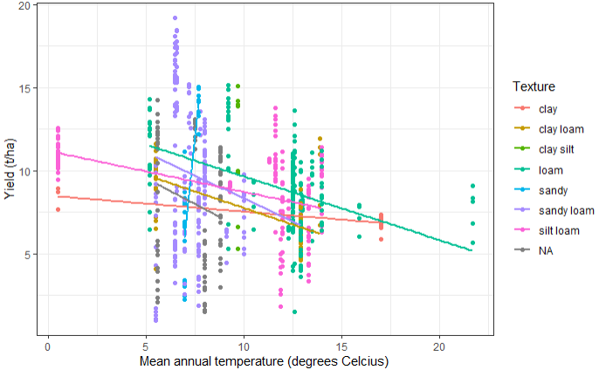
Temperature and Yield
Increasing temperature seemed to have a negative effect on yield
Perhaps warmer climates have longer growing seasons -> soil depleted of nutrients
Soil type and temperatures correlated due to geographic region

Slide 13
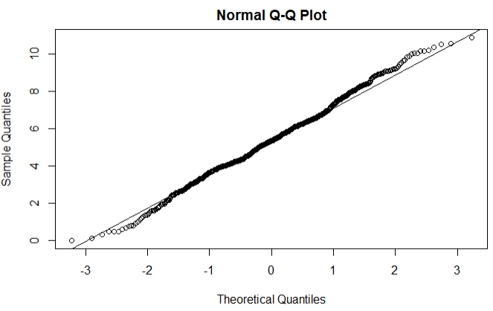
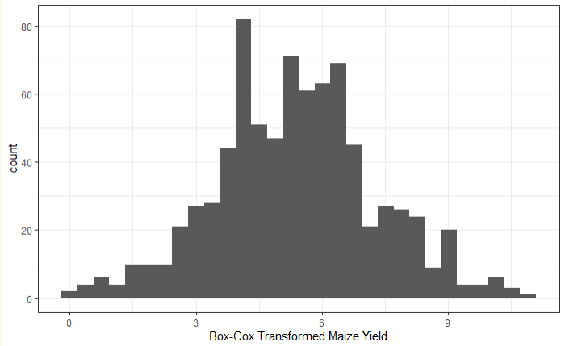


Proposed Likelihood for Maize Yield
Box-cox transformation on maize yield to transform it into a normal variable (simpler for modelling)
$y → \frac{y^{λ}−1}{λ} , λ≈0.7$07
Normal likelihood for transformed maize yield

Slide 14
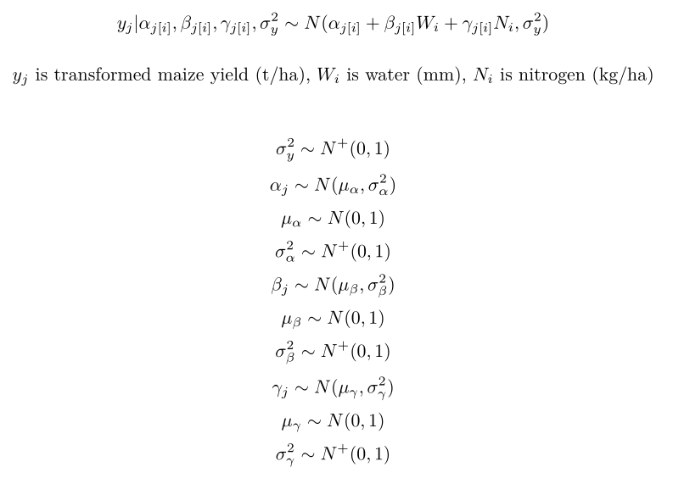
Proposed Bayesian Hierarchical Model
Variables will be centered
No correlation between water, nitrogen, density
Temperature correlated with soil
No association between SOC and yield, other variables
Stratify on soil type (ordered by particle size)
Within each soil type, consider effects of water, nitrogen, (and maybe plant density if dealing with missing data is manageable)

